Slide 1
Cluster Cloud Computing Presentation
Group 22
Ran Liang, Yulun huang, yanhao wang, yubo sun, Xindi FANG

Slide 2
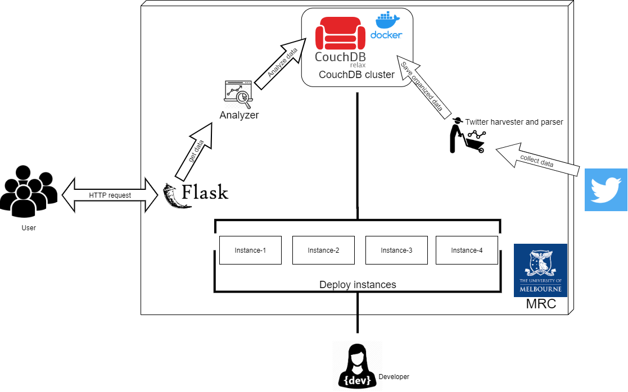
Architecture of The System

Slide 3
Scenarios
How different language tweets correlated to language spoken at home?
What is the difference between iPhone and Android users towards twittering?
What is the pattern of people accessing tweets in 24 hours period?
What is the trends of attention and attitudes of people towards Covid vaccines?
What is the trends of attention and attitudes of people towards unemployment?
What is the correlation of people talking about unemployment on tweet and the unemployment and youth unemployment rate?

Slide 4
Link To Our Web
http://172.26.130.240:5000/

